Slide 1
Harnessing Political Will to End Urban HIV Epidemics
Dr. José M. Zuniga, President/CEO, IAPAC

Slide 2
DISCLOSURES
No Conflicts of Interest to Declare
This Photo by Unknown Author is licensed under CC BY-SA

Slide 3
Fast-Track cities
Fast-Track Cities was launched World AIDS Day 2014 in the City of Paris
26 original cities signed Paris Declaration on Fast-Track Cities
Paris Declaration on Fast-Track Cities amended in July 2018
300+ cities have joined the network in every region
Brazil, France, South Africa, Ireland, Portugal, Spain, UK, USA, etc., have critical mass of Fast-Track Cities

Slide 4
Calculus for success
Political will and commitment
Mayors, parlimentarians, citizens
Community engagement
MIPA and “Right to the City” principles
Public health leadership
Technical handshake (all levels)
Data-driven, equity-based planning
Transparent use of data (accountability)
Health system capacity-building
Continuum optimization
Stigma/discrimination elimination
QoC/QoL assessments (CQI)
Best practice sharing

Slide 5
Governance for health
Sustained commitment
Community engagement
Paris Declaration on Fast-Track Cities:
Focus efforts on all people vulnerable to HIV and other diseases (i.e., TB)
Help to realize human rights of all affected people and communities
Sustained commitment to and active/visible engagement predict upward trends in 90-90-90, can decrease stigma/discrimination
Meaningful engagement of affected communities translates into:
Policy-making
Health finance planning
Program/service delivery
Accountability
Healthy, resilient societies require realizing a ‘right to the city’ that asserts everyone has a right to shape, design, and operationalize an urban human rights agenda

Slide 6
Municipal finance
Health financing
POLITICAL engagement
Health financing complicated by complexities in who is responsible for and who pays for health services
In some countries, cities cannot retain for their own use GDP they generate
Budget constraints resulting from economic downturns thwart efforts
Gaps in health financing data affect effective, efficient decision-making
Political engagement at all levels of jurisdictional authority (beyond city)
Community accountability framework
Beyond clinical to supportive services (housing, transportation, food)
Expansion of government benefits for low-income residents a hallmark of successful HIV responses

Slide 7
Tale of two cities
Signed on as Fast-Track City in 2015
No political or community engagement since signing Paris Declaration on Fast-Track Cities
City-level data not available to assess baseline, identify 90-90-90 and HIV care continuum gaps (maybe in early 2020?)
Municipal and federal elections fostered “chaotic” environment for HIV response
Opportunity exists to bring all key stakeholders together to focus/accelerate México City’s HIV response
LONDON (95-98-97)
Signed on as Fast-Track City in 2018
Mayor’s Office, London Councils, PHE, NHS negotiated political, operational issues
Formed FTC London “Kick-Start” and Leadership Group to guide efforts
Engaged in implementation planning, including pan-London gap/asset analysis
Leveraged Fast-Track Cities brand for national PrEP scale-up advocacy
Secured £6 million from NHS for Fast-Track Cities-aligned ‘Getting London to Zero’
MExico City (N/A)

Slide 8
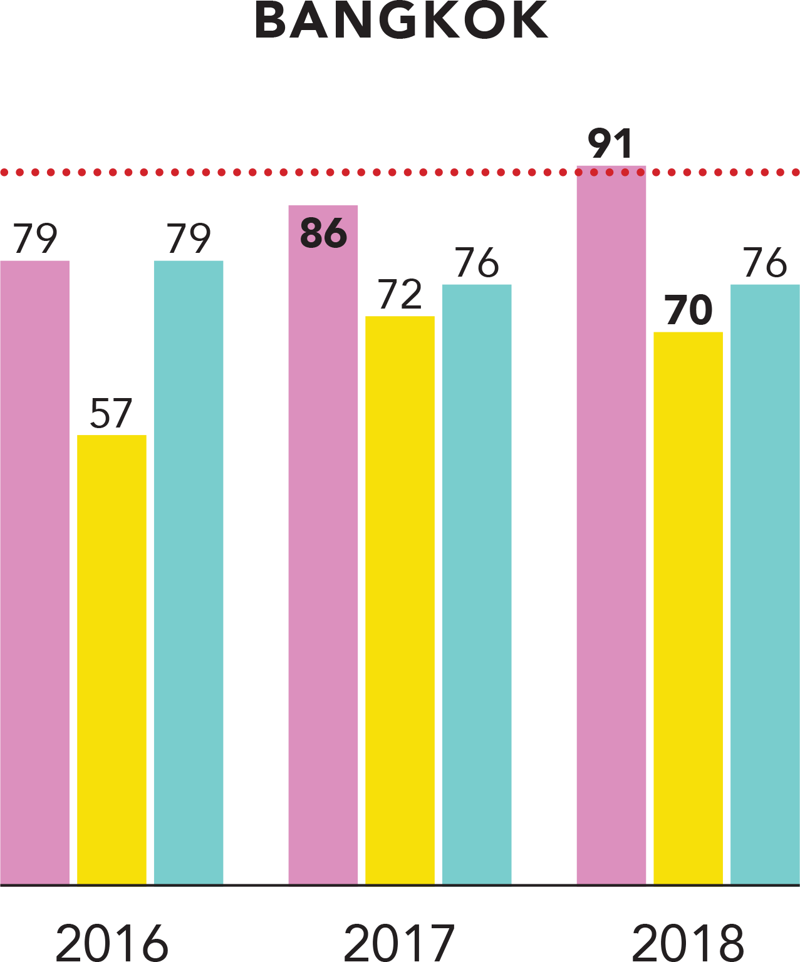
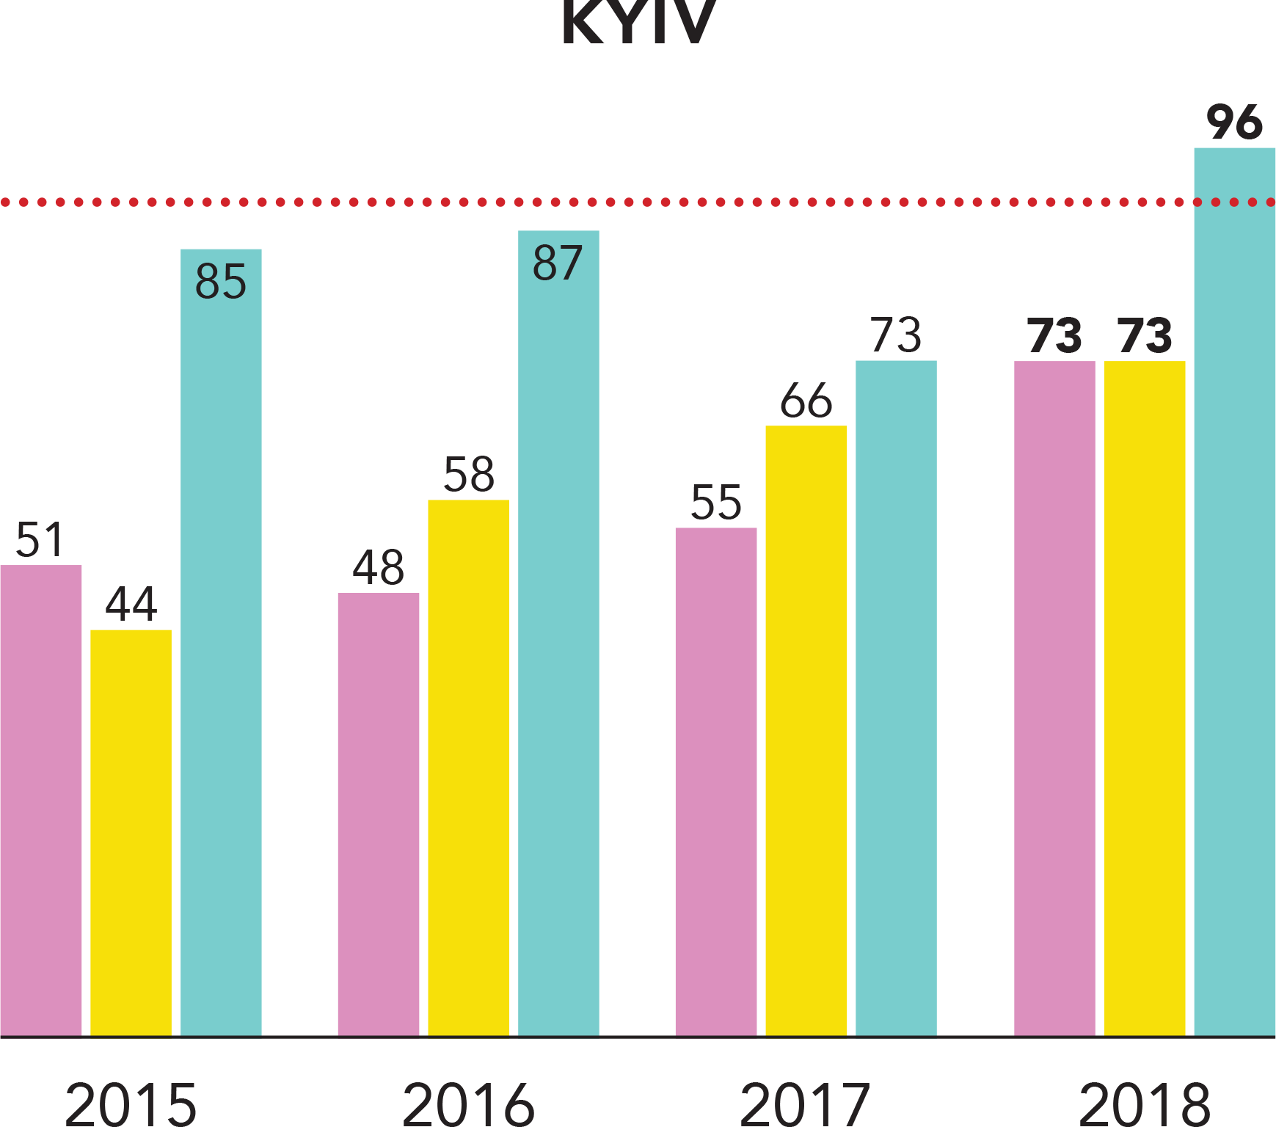
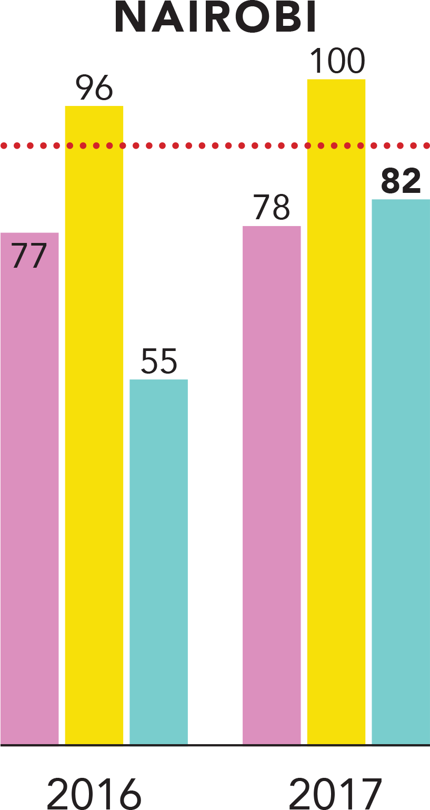
DATA for impact

Slide 9
POLITICAL WILL
Mayor Herman Mashaba
Mayor Femke Halsema
Mayor Delroy Williams
Mayor JoY Belmonte
“Cities should be at the forefront of battling the HIV epidemic. After all, it is municipalities and cities like Johannesburg that are at the coalface of service delivery.”
“If cities like Amsterdam cooperate in the Fast-Track Cities initiative, urban centers around the world will benefit from exchanging lessons learned in getting to zero.”
“Urbanized parishes in Jamaica have the greatest number of HIV cases. As custodians of the well-being of Kingston, we have a vested interest in the Fast-Track Cities initiative.”
“Quezon City is an example of committed HIV leadership. We prioritized the HIV response in to pursue zero new infections, zero AIDS-related deaths, and zero discrimination.”

Slide 10
www.fast-trackcities.org

